Slide 1
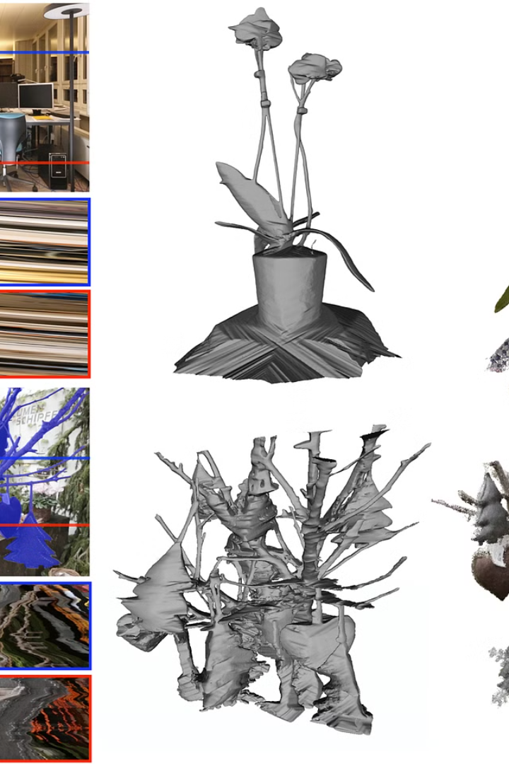
Introduction to 3D Object Reconstruction
3D object reconstruction is the process of capturing the shape and appearance of a physical object and creating a digital 3D model. This powerful technique has a wide range of applications, from virtual prototyping and product design to digital preservation and medical imaging.
by
P. Karthik Rao(192224109)
A.V.Akhileshwara Reddy(192224115)
RK

Slide 2
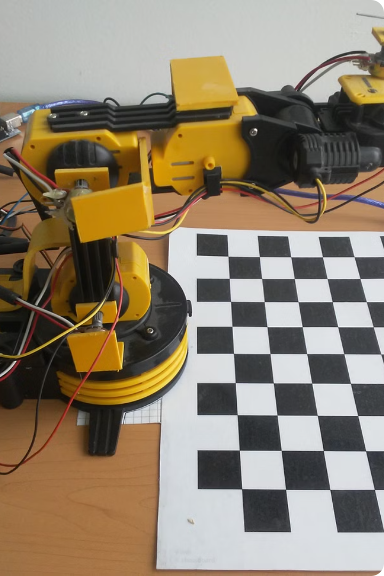
Overview of OpenCV for 3D Reconstruction
OpenCV (Open Source Computer Vision Library) is a powerful tool for developing 3D reconstruction applications. It provides a comprehensive set of computer vision algorithms and tools that enable efficient extraction of 3D information from 2D image data.
With OpenCV, you can leverage advanced techniques like feature detection, matching, and structure-from-motion to reconstruct the 3D geometry of objects from multiple camera views.

Slide 3





Working of this system
Capture Images
1
Use multiple cameras to capture 2D images of the 3D object from different viewpoints.
Camera Calibration
2
Determine the intrinsic and extrinsic parameters of the cameras to understand their positions and orientations.
Feature Extraction
3
Identify distinctive features in the images that can be matched across multiple views.
Feature Matching
4
Establish correspondences between the features detected in the different images.
Triangulation
5
Use the matched features and camera parameters to reconstruct the 3D positions of points on the object.
The 3D object reconstruction system works by capturing multiple 2D images of the object from different viewpoints. The camera parameters are then calibrated to understand their positions and orientations. Next, distinctive features are extracted from the images and matched across the different views. Finally, the 3D positions of the object's points are reconstructed through a process called triangulation.

Slide 4
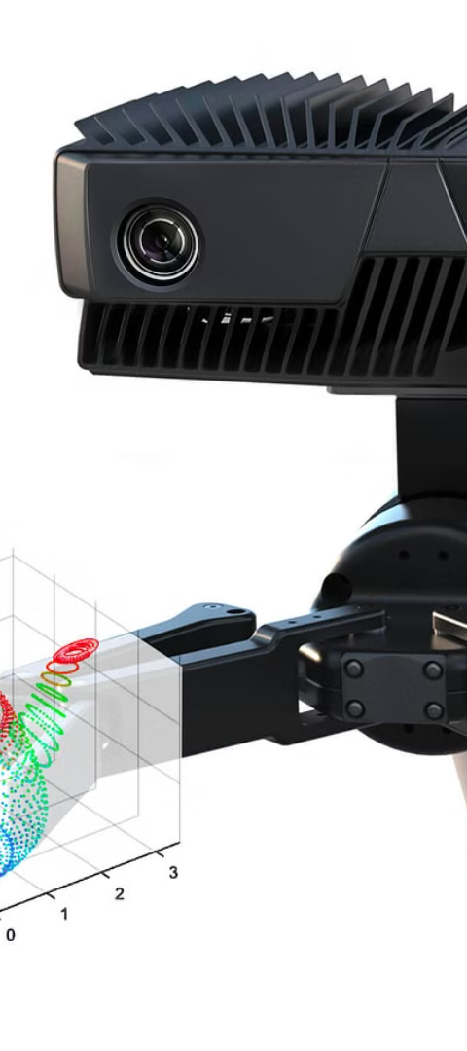
Capturing Multiple Images of an Object
1
Camera Placement
Position multiple cameras around the object, ensuring they capture the object from different angles and perspectives.
2
Controlled Lighting
Carefully light the scene to minimize shadows and ensure consistent illumination across all captured images.
3
Synchronized Capture
Coordinate the cameras to capture images simultaneously, allowing for precise alignment and reconstruction later.

Slide 5
Camera Calibration and Pose Estimation
Intrinsic Parameters
1
Determine the internal properties of the cameras, such as focal length, sensor size, and lens distortion.
Extrinsic Parameters
2
Establish the position and orientation of the cameras relative to the object being scanned.
Calibration Process
3
Use calibration targets and optimization algorithms to accurately estimate the camera parameters.
The camera calibration and pose estimation step is crucial for 3D object reconstruction. By determining the intrinsic parameters of the cameras and their extrinsic positions relative to the object, we can accurately triangulate the 3D points and create a faithful digital representation of the physical object.

Slide 6
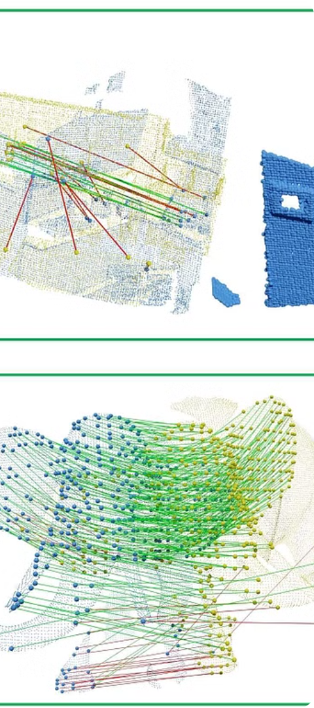
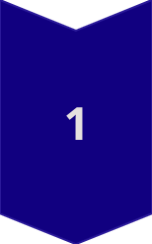
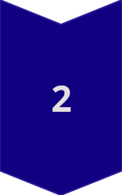
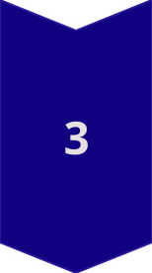
Feature Extraction and Matching
Detect Features
Use advanced computer vision algorithms like SIFT or SURF to identify distinctive keypoints and features in the captured images.
Describe Features
Generate descriptors for the detected features, capturing their unique visual characteristics and appearance.
Match Features
Establish correspondences between the features detected in the different images by comparing their descriptors and finding the best matches.

Slide 7
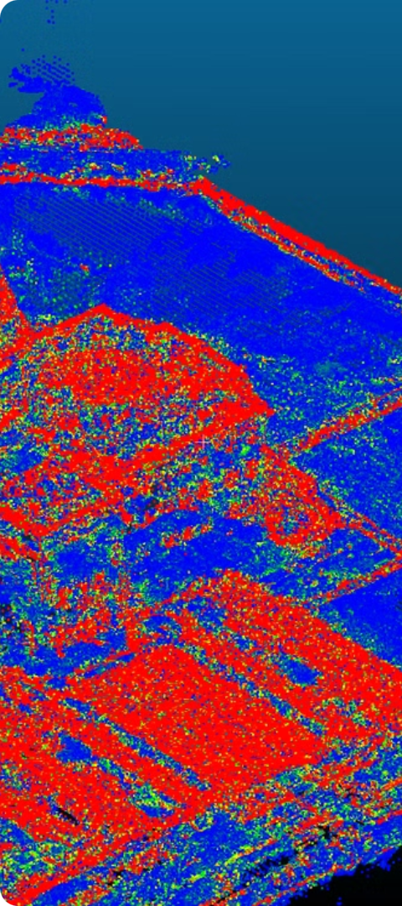
Triangulation and Point Cloud Generation
1
3D Reconstruction
Using the matched features across multiple views, triangulate the 3D positions of the object's points through geometric analysis.
2
Point Cloud Creation
Aggregate the triangulated 3D points into a dense point cloud, representing the surface geometry of the scanned object.
3
Refine and Optimize
Apply advanced algorithms to clean up the point cloud, remove outliers, and ensure a high-quality, accurate representation.

Slide 8



Mesh Generation and Texturing
Triangulation
1
Convert the dense point cloud into a polygonal mesh representation.
Surface Reconstruction
2
Fill in any gaps and smooth out the mesh to create a watertight 3D model.
Texture Mapping
3
Project the captured 2D imagery onto the 3D mesh to add realistic surface details.
Once the 3D point cloud has been generated, the next step is to convert it into a polygonal mesh representation. This involves connecting the points into a series of triangles or other polygons to create a continuous surface. Advanced surface reconstruction algorithms are then used to fill in any gaps and smooth out the mesh, producing a high-quality, watertight 3D model. Finally, the original 2D images are projected onto the 3D mesh, mapping the captured textures and details onto the virtual object.

Slide 9
Potential Applications and Limitations
Diverse Applications
Accuracy Limitations
3D object reconstruction has a wide range of applications, from virtual prototyping and product design to cultural heritage preservation and medical imaging.
The accuracy of the reconstructed 3D model can be affected by factors like image quality, camera calibration, and the complexity of the object's geometry.
Hardware Requirements
Occlusion Challenges
Capturing high-quality images and performing 3D reconstruction requires specialized hardware, such as multiple synchronized cameras and powerful computing resources.
Objects with complex shapes or that are partially occluded can be difficult to reconstruct accurately, as some details may be missing from the captured images.

Slide 10
Conclusion
In conclusion, 3D object reconstruction using OpenCV offers a powerful and versatile solution for capturing the digital essence of physical objects. By leveraging advanced computer vision techniques, this system can create highly detailed, realistic 3D models from multiple camera views.

